Slide 1
Anxiety

Slide 2
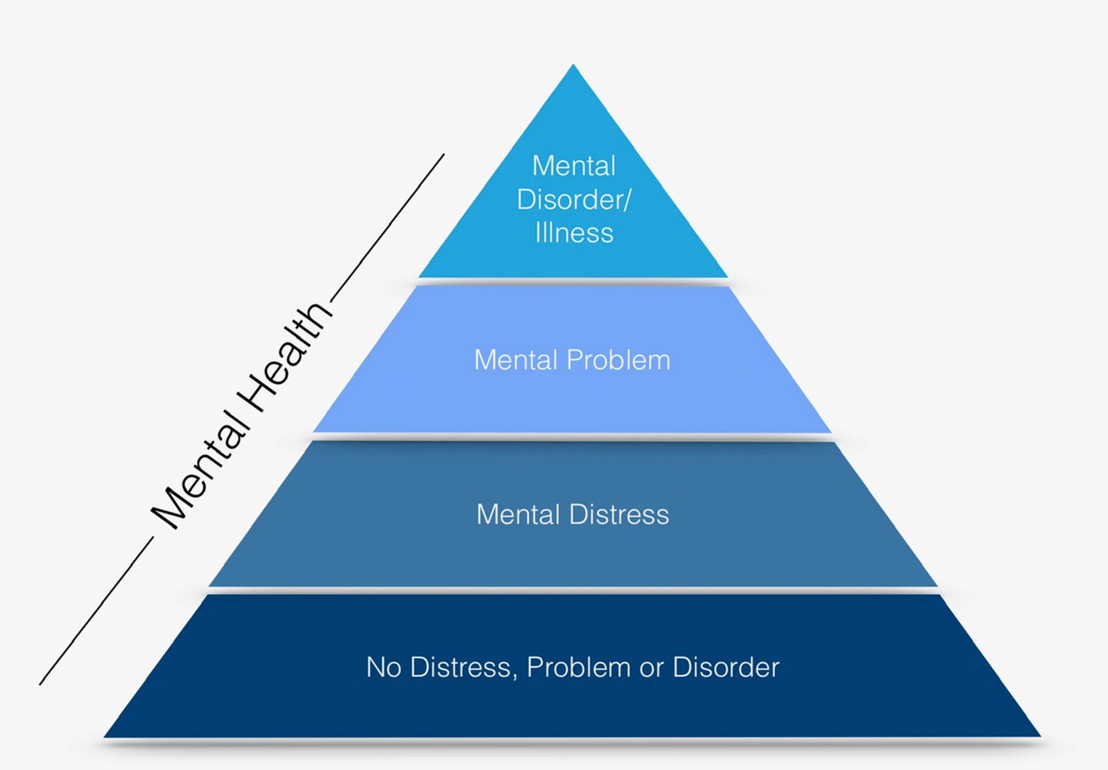
Mental Health is all States
Click here to watch a video explaining mental health states.
https://www.youtube.com/watch?v=LsowyMnqCRs
You can flow back and forth between states and exist in more than one state at a time.

Slide 3
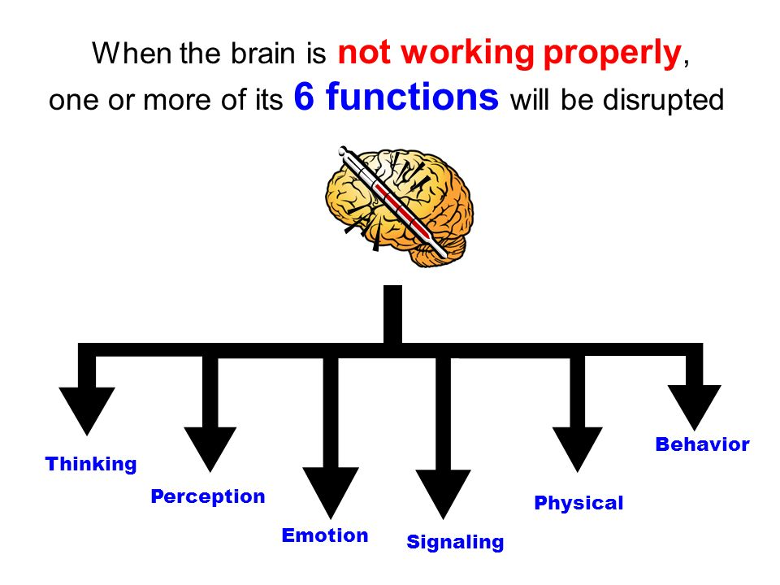
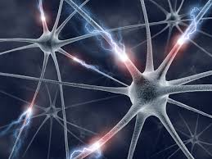
What happens when the brain gets sick
When the brain gets sick a specific part of the brain may not be working well or may be working in the wrong way
Or when a brain network is disrupted and the communication pathways between different parts of the brain are not working properly

Slide 4
What can cause anxiety?
Genetics
Injury to the brain (such as concussion)
Infection of the brain
Tumor of the brain
Effect of severe and persistent stress
Toxins from the environment – such as drugs

Slide 5
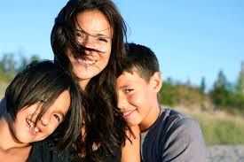
Protective Factors for Anxiety
Good physical health (SEEC)
Family
Friendships
School connectedness
Cognitive and coping styles
Spiritual connection
Connect to culture and elders
Self esteem
SEEC good mental health
Sleep
Eat Exercise
Connect

Slide 6
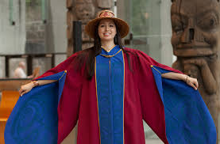
Youth in BC are staying well, even during the pandemic. See their videos and read their pages to find out what they are doing to feel connected.
https://www.fnha.ca/wellness/wellness-for-first-nations/youth-and-covid-19

Slide 7
Stigma
Watch these videos about stigma:
https://www.youtube.com/watch?v=49mfPFTZsHs
https://www.youtube.com/watch?v=-MLBmSj6Q_s
Stigma refers to “a cluster of negative attitudes and beliefs that motivate the general public to fear, reject, avoid and discriminate against people with mental illness. Stigma is not just a matter of using the wrong word or action. Stigma is about disrespect. It is the use of negative labels to identify a person living with mental illness. Stigma is a barrier. Fear of stigma and the resulting discrimination discourages individuals and their families from getting the help they need.” (SAMHSA, 2004)
One way to help decrease stigma is to challenge myths with data and with scientific knowledge

Slide 8
Anxiety and Children
About 70% of all mental illnesses can be diagnosed before 25 years of age
When they start, most mental illnesses are mild or moderate and respond well to proper treatments
Knowing about mental illnesses is essential for getting help early
Anxiety is the most common mental health concern worldwide
5% of student experience clinical anxiety

Slide 9
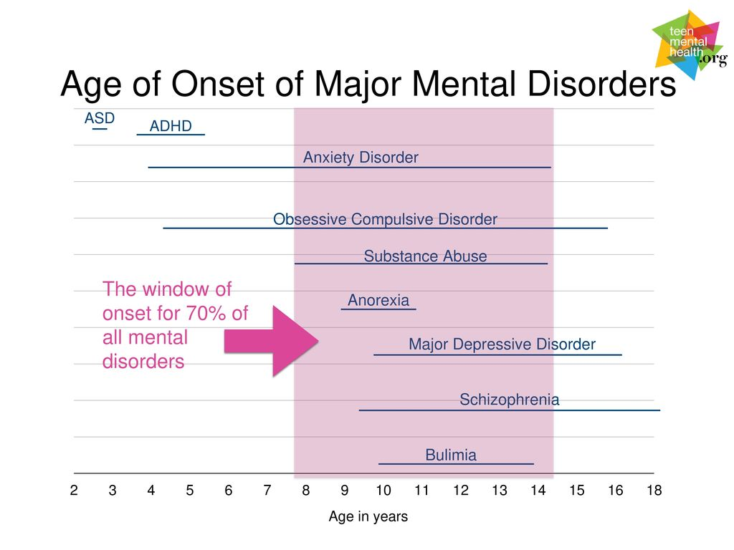

Slide 10
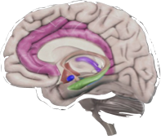
Healthy Signaling
Brain registers danger
Flight
Fight
Freeze
Danger!!!
Changes in the body and stress hormones
Sensory Perception and Internals signals

Slide 11
Anxiety
Brain registers danger
Anxiety
NO Danger!!!
Changes in the body and stress hormones (adreleine and cortisol
Sensory Perception and Internals signals

Slide 12
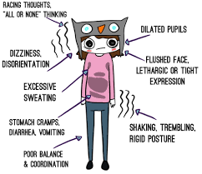
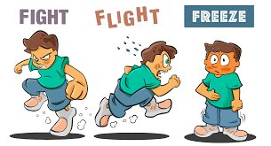
The Signaling Response
Click on this link to learn more about the fight, flight or freeze response.
https://www.youtube.com/watch?v=rpolpKTWrp4&feature=emb_logo
How does your body respond to anxiety?

Slide 13
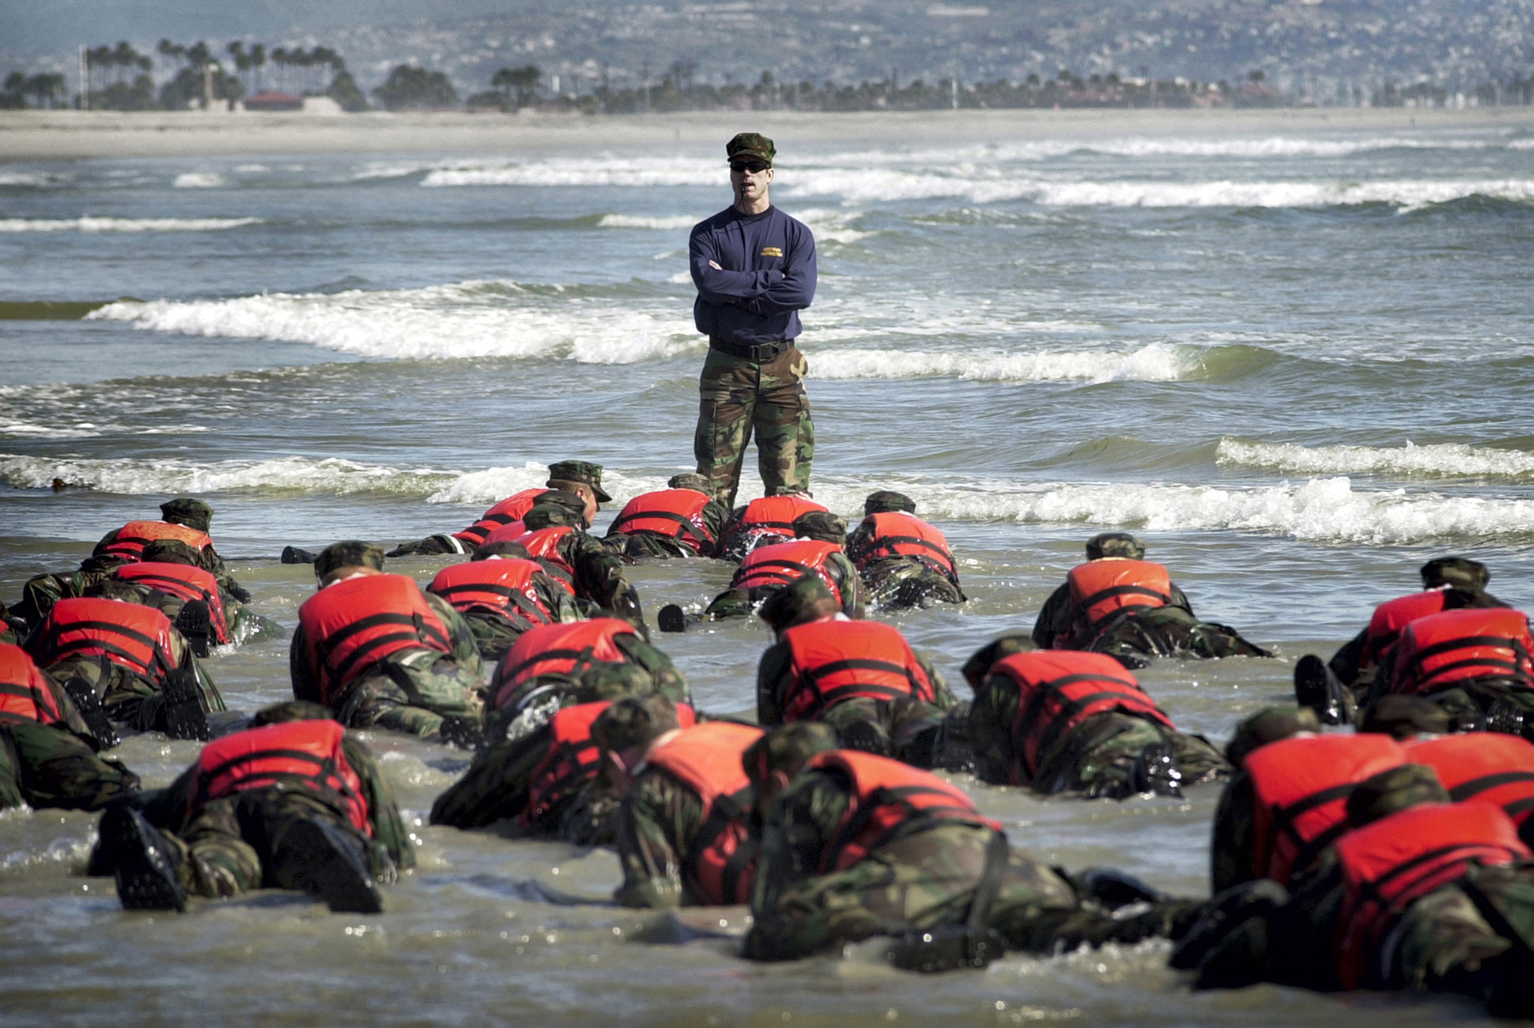
Learn to deep breathe

Slide 14
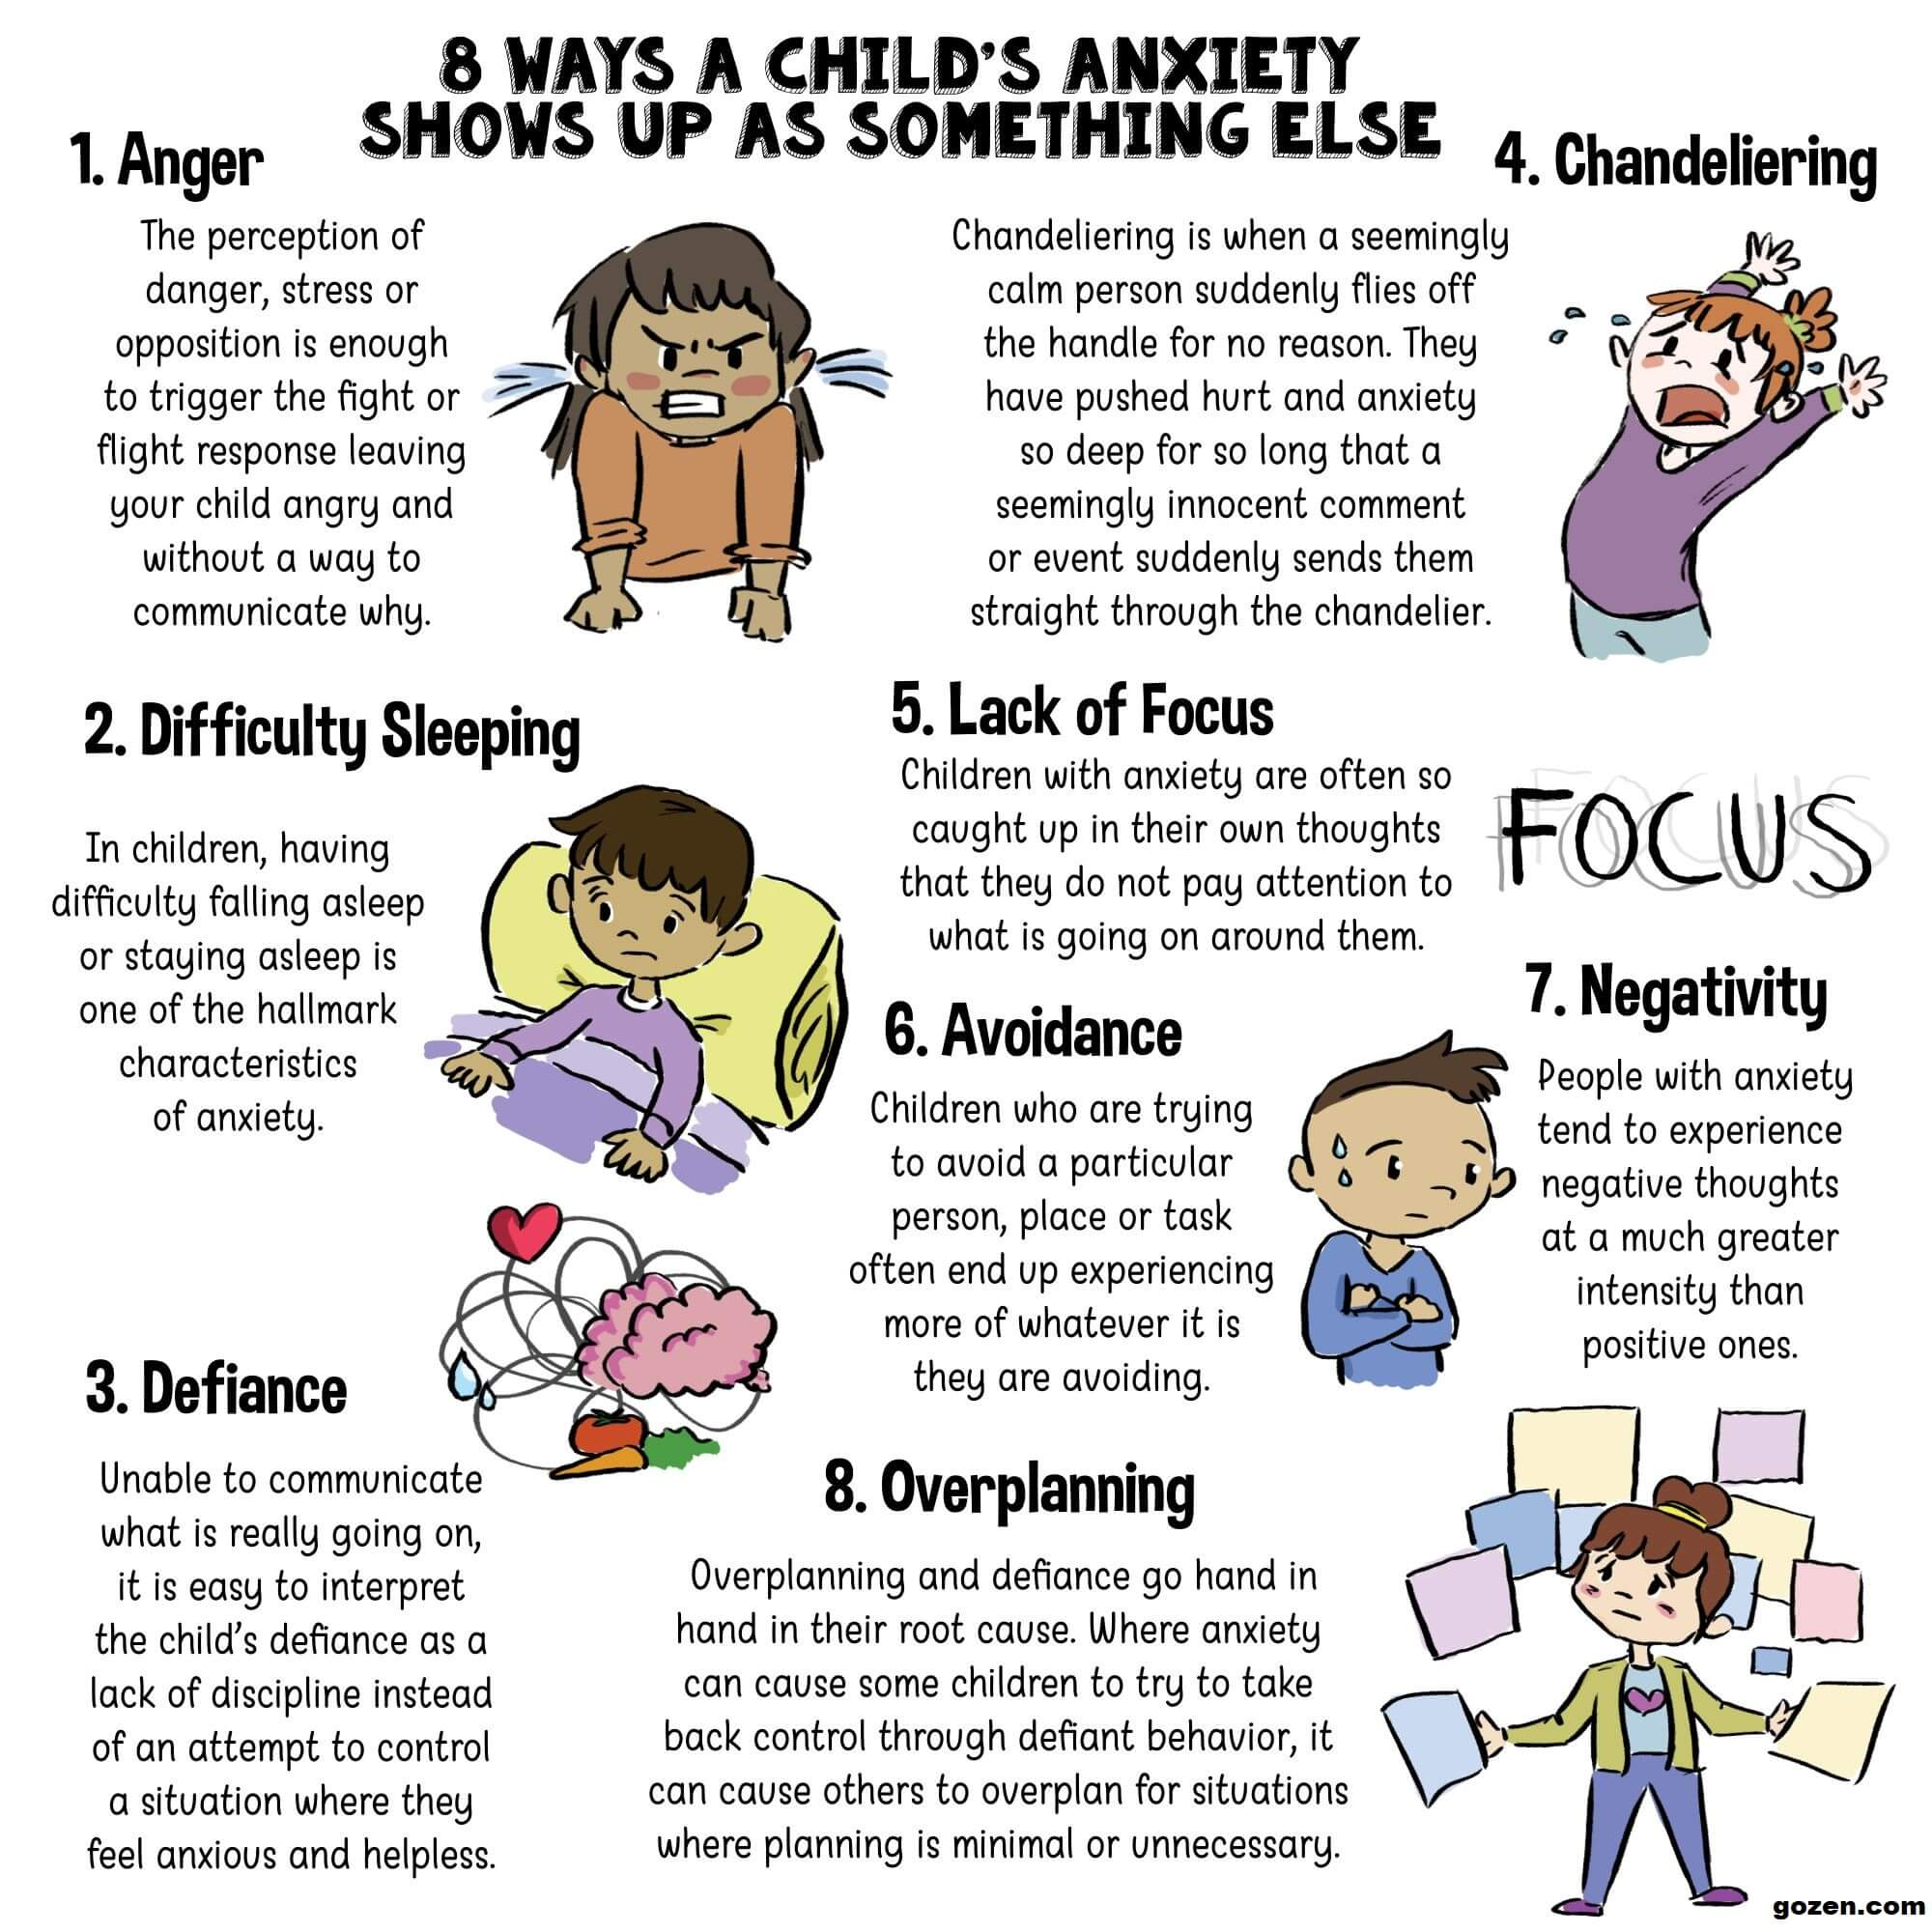

Slide 15
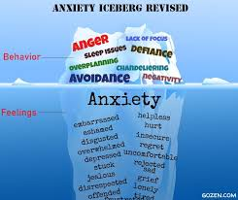
What experiences have you had with Anxiety?
Anxiety can be helpful! How can you think of anxious feelings as positive?

Slide 16
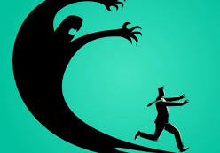
Disorders of Signaling
Anxiety
Social Anxiety Disorder
Panic Disorder
Obsessive Compulsive Disorder
Post-Traumatic Stress Disorder
https://www.youtube.com/watch?v=gm9CIJ74Oxw
Flipping your lid video – the brain explained

Slide 17
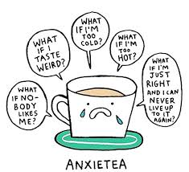
General Anxiety Disorder
Persistent distressing physical symptoms related to an over response versus an underlying medical cause – such as headaches, stomachaches, pain etc.
Worrying about many things (much more than others) and seeking constant reassurance
Having trouble “letting go” of the worry
Usually seeming tense or “on edge”
Worrying with a level of intensity that interferes with enjoying life or participating in desired activities or events
Approximately 1% of young people

Slide 18
Social Anxiety Disorder
People who have SAD experience severe fear/high anxiety in social situations
They think that they are being closely watched, judged or criticized by others
They think they will be embarrassed or humiliated
As a result, they avoid social situations (speaking in class, going to a party, etc.)
Sometimes they can experience a panic attack but only in a social situation
Click to watch a short video​
https://www.youtube.com/watch?v=kitHQUWrA7s

Slide 19
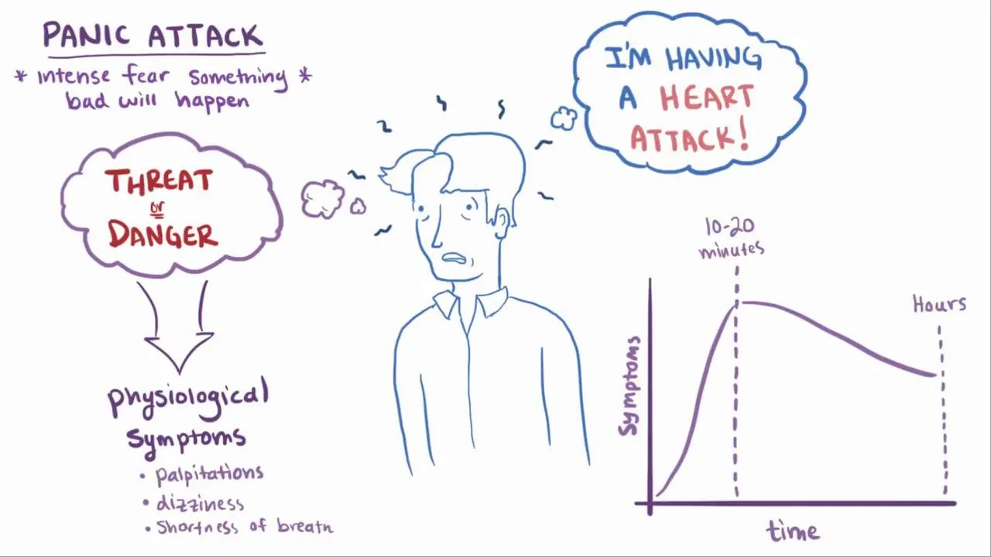
Panic Disorder
People who have PD experience frequent panic attacks that just “come out of the blue”
They also develop anxiety about having an attack
And, they avoid going to places where they think they may experience an attack
Click to watch a short video​
https://www.youtube.com/watch?v=R3S_XYaEPUs

Slide 20
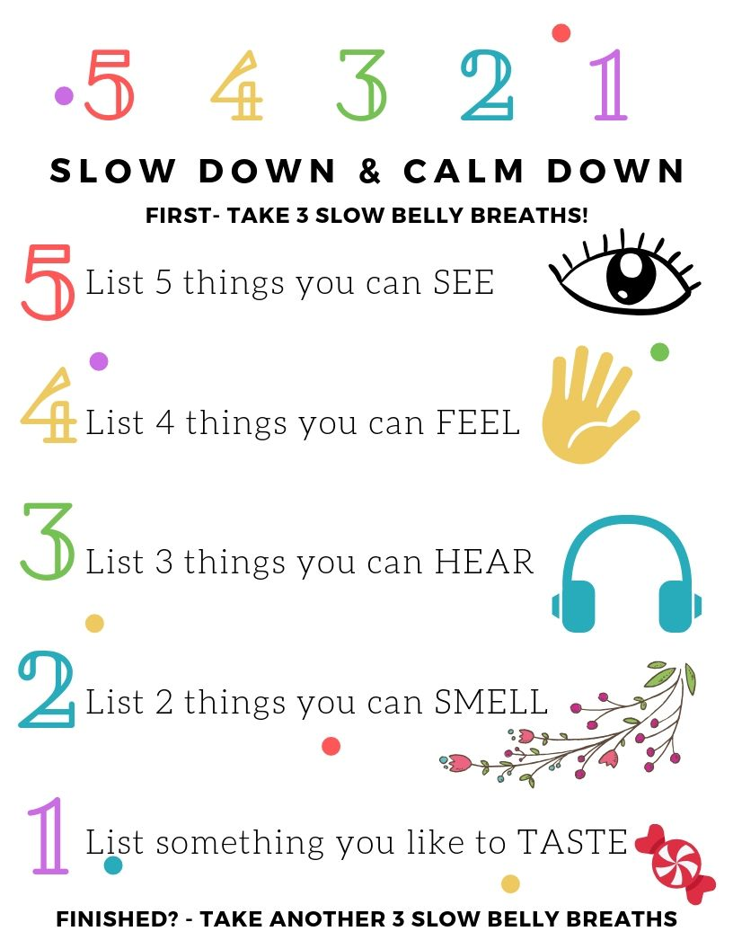
Grounding Techniques
Look at this link to learn more about physical and mental grounding techniques:
https://www.healthline.com/health/grounding-techniques

Slide 21
Obsessive Compulsive Disorder (OCD)
OCD has two components: obsessions and compulsions
Obsessions are severe, recurrent, persistent thoughts that a person knows are not true but cannot stop
Common obsessions include: germs/dirt, thoughts that something terrible will happen, unwanted sexual or religious thoughts, etc.
Compulsions are repetitive actions that the person does to try and decrease their discomfort from having compulsions
Common compulsions include: washing, brushing, counting, tapping, chanting, putting objects into specific order, etc.
Obsessions and compulsions seem to run a person’s life
Click to watch a short video​
https://www.youtube.com/watch?v=ua9zr16jC1M

Slide 22
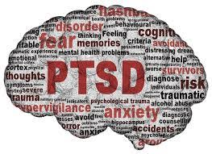
Post Traumatic Stress Disorder (PTSD)
After a severe traumatic event (e.g. witness to murder, rape, automobile accident, etc.) everyone will experience significant distress and many symptoms (e.g. trouble sleeping, flashbacks about the event, feeling worried/restless,etc.)
This is normal, it’s called the Acute Stress Response, and will usually go away gradually over about 4-6 weeks
PTSD is the persistence of severe symptoms of: re-experiencing the event, hyper arousal (trouble sleeping, excessive worry/restlessness), avoidance of things that remind of the event, numerous negative emotions and thoughts
These symptoms cause significant problems in daily living

Slide 23
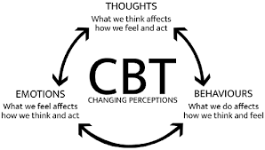
Treatment for Signaling Disorders
Effective treatments for Anxiety Disorders are available
Usually a psychological therapy called Cognitive Behavioral Therapy (CBT) is used
Sometimes a medication is also used in addition to the CBT

Slide 24
Strategies for Anxiety Management

Slide 25
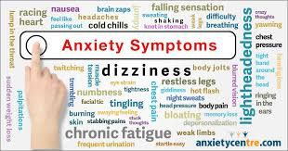
How does anxiety affect your thoughts, feeling and behaviours?

Slide 26
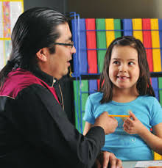
Helping Children Find Their Feelings Sometimes it’s hard for adults to know what to say or do to ease a child’s worries, especially during times of change and uncertainty. As the most important big people in their world, parents and caregivers can help children feel safer and soften the sharp edges of whatever is happening to make their worries grow. What is it? Children may have a hard time identifying the intense and confusing feelings that come with all the changes in their world. They might be feeling frustrated, worried, restless, hopeful, angry, and overwhelmed all at the same time. Learning to recognize emotions and find acceptable ways to express them can keep them from staying bottled up inside or acted out in unsafe ways. How? Talk about feelings with your child. Read books or watch videos about different emotions and ask if your child is having any of the same feelings.

Slide 27
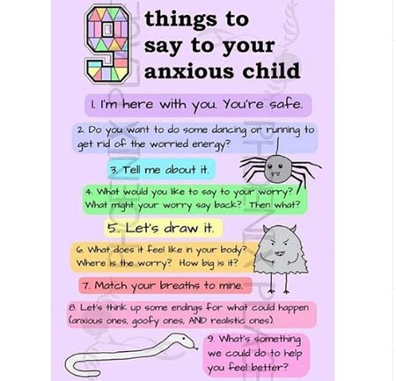
Co-regulate and Model

Slide 28
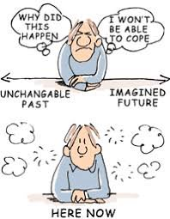
Mindfulness
The scientific power of meditation​
https://www.youtube.com/watch?v=Aw71zanwMnY​

Slide 29
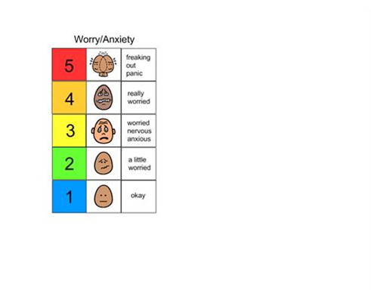
Worry Scale
Scale your worries and think of one thing you can do or think to bring the worry down a level.
Scale your worry. Next, think of something that you can do or think to bring you down one level.

Slide 30
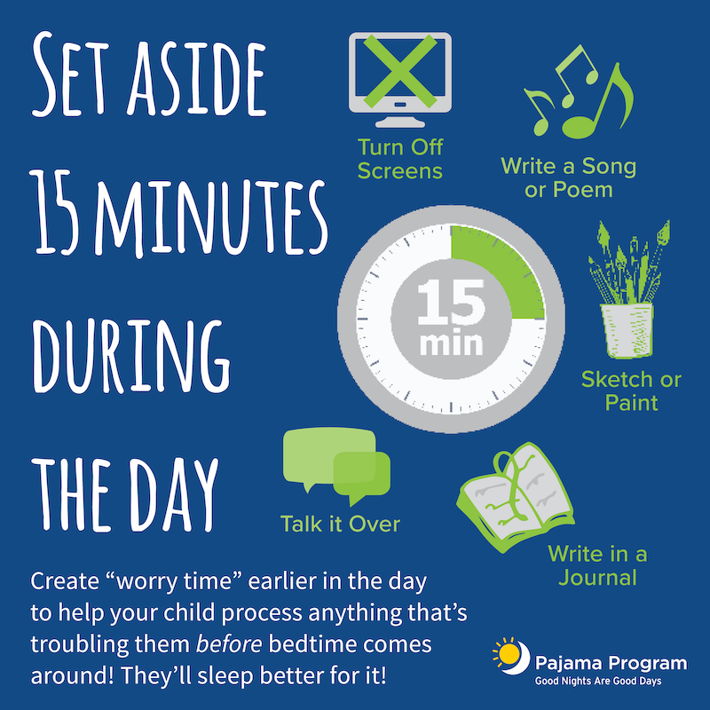
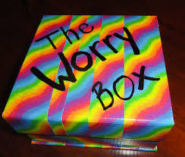
Manage your Worry Time
Schedule your worry.
Write down worries and put them in a "worry box" for safe-keeping.
Trap your worries

Slide 31
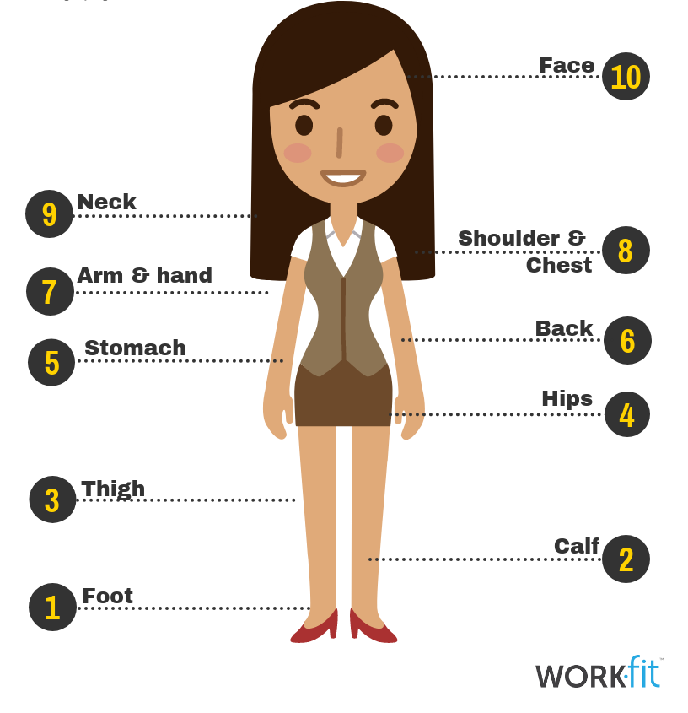
Relaxation and Chill out Tools
Body scan
Happy Place
https://www.youtube.com/watch?v=ihwcw_ofuME
https://www.youtube.com/watch?v=mmkxOQzI6pk
Progressive Muscle Relaxation
https://www.youtube.com/watch?v=Q_diV-uqV9w
Movement Breaks
https://www.youtube.com/watch?v=5EHB03268NQ

Slide 32
Understanding Thoughts
Spot the thought
Stop the thought

Slide 33
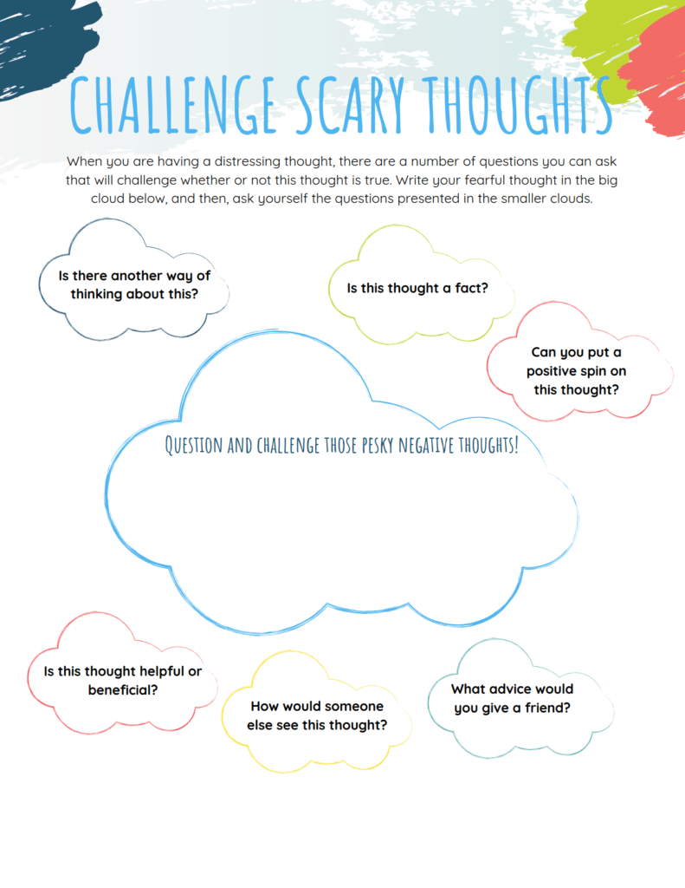

Slide 34
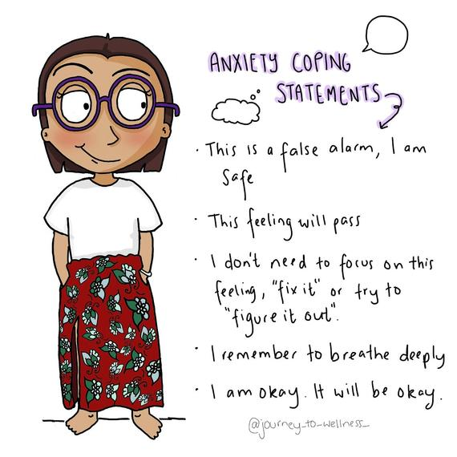
Think of some statements you can use when anxious.

Slide 35
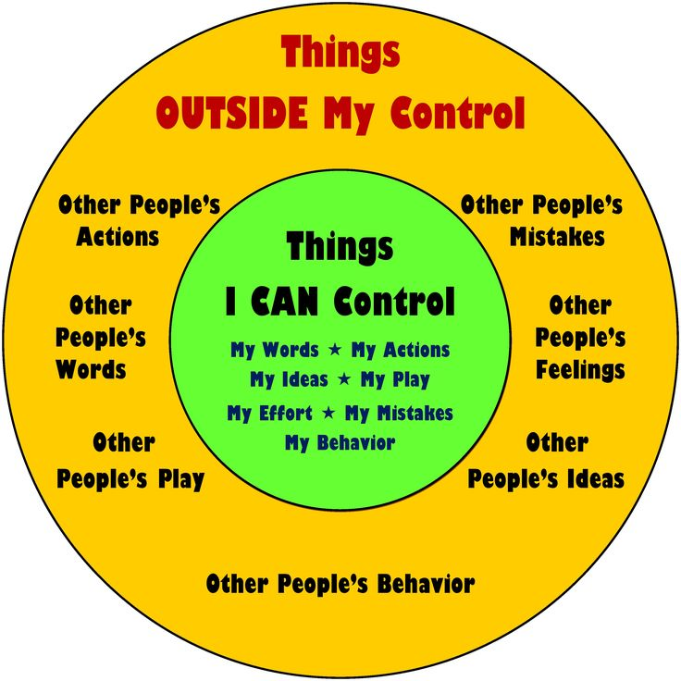
Focus on what you can do

Slide 36
Let anxious thoughts go
Instead of analyzing, challenging, or replacing an anxious thought with a more helpful thought, you can simply observe it and acknowledge that it is just a thought. See if you can just let it go without giving it any power.
Be curious about your thoughts, without getting caught up in them. It’s like standing outside yourself watching your thoughts come and go.

Slide 37
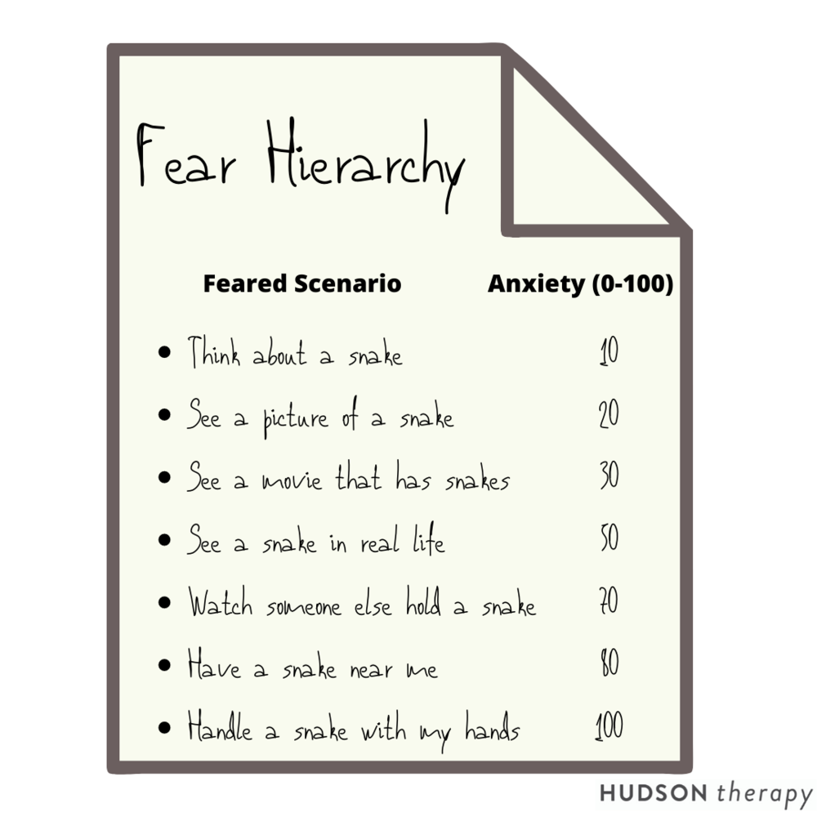
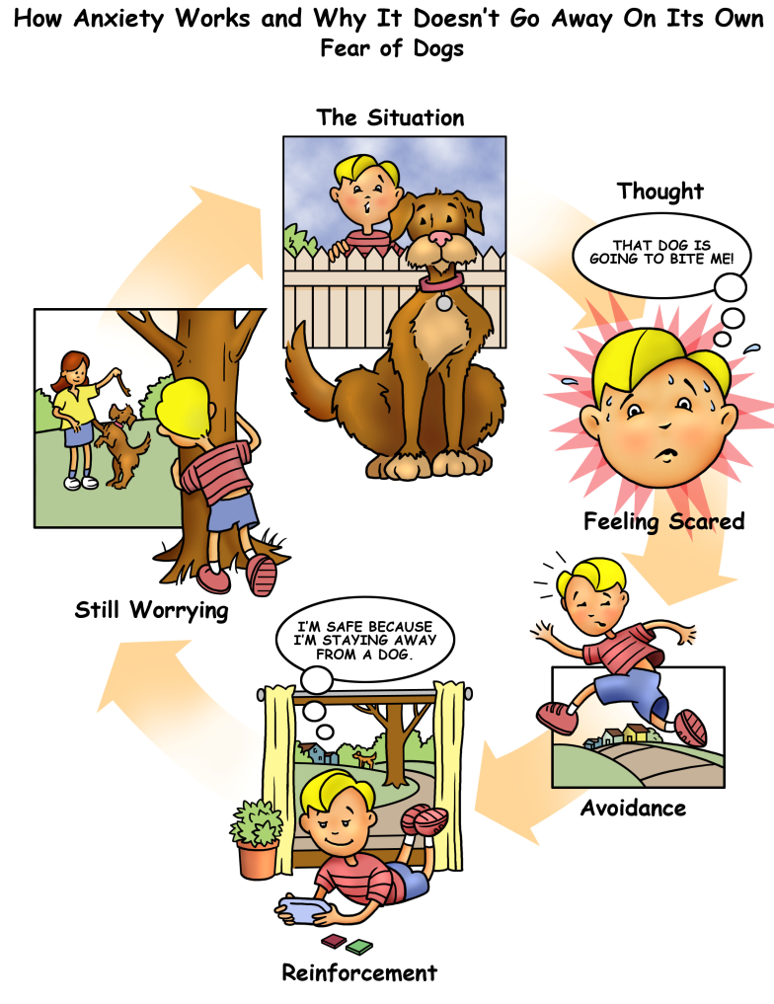
Taking Brave Steps
Click here to learn about facing your fears
https://www.youtube.com/watch?v=NjQZhC7bKps

Slide 38
EASE at home (for parents and caregivers) Everyday Anxiety Strategies
In response to the COVID-19 pandemic, the EASE classroom activities were adapted for use at home by parents and caregivers to support children's mental health and continuous learning.
These fun and practical strategies help guide parents and caregivers in managing their children’s anxiety and worries in the comfort of their home during the COVID-19 pandemic and beyond.
https://www2.gov.bc.ca/gov/content/health/managing-your-health/mental-health-substance-use/child-teen-mental-health/ease

Slide 39
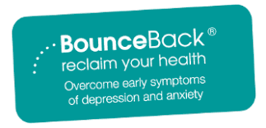
Online Help
https://www.anxietycanada.com/
https://bouncebackbc.ca/

Slide 40
Check out these helpful mental health websites
https://keltymentalhealth.ca/
https://cmha.ca/
https://www.heretohelp.bc.ca/
https://www.fnha.ca/wellness

